Slide 1
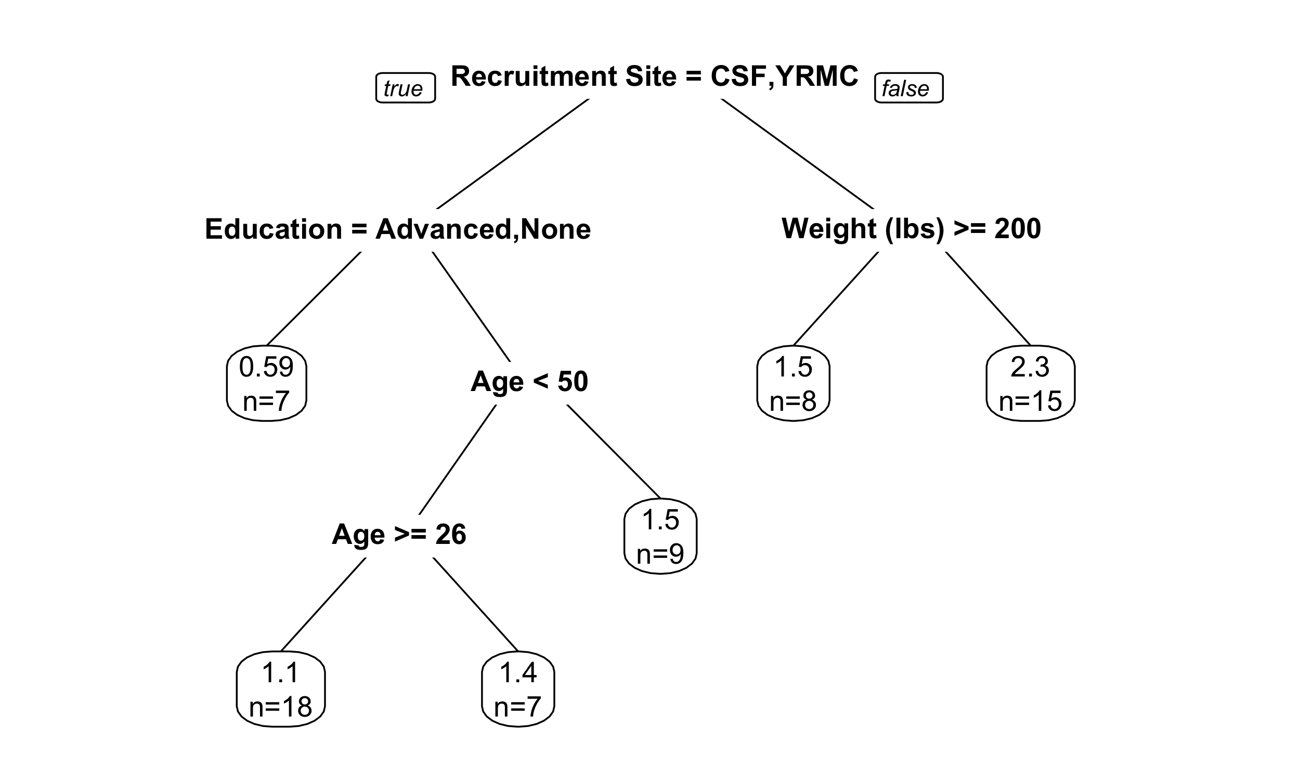
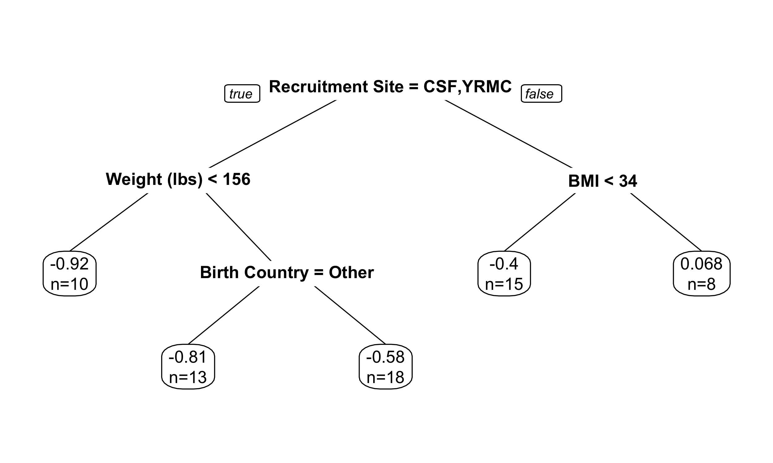
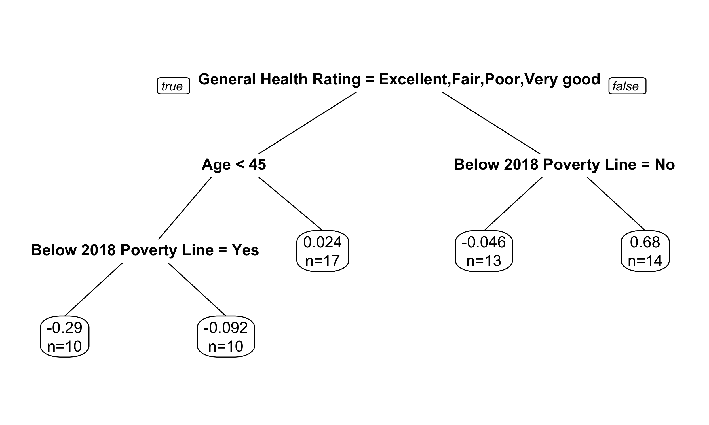
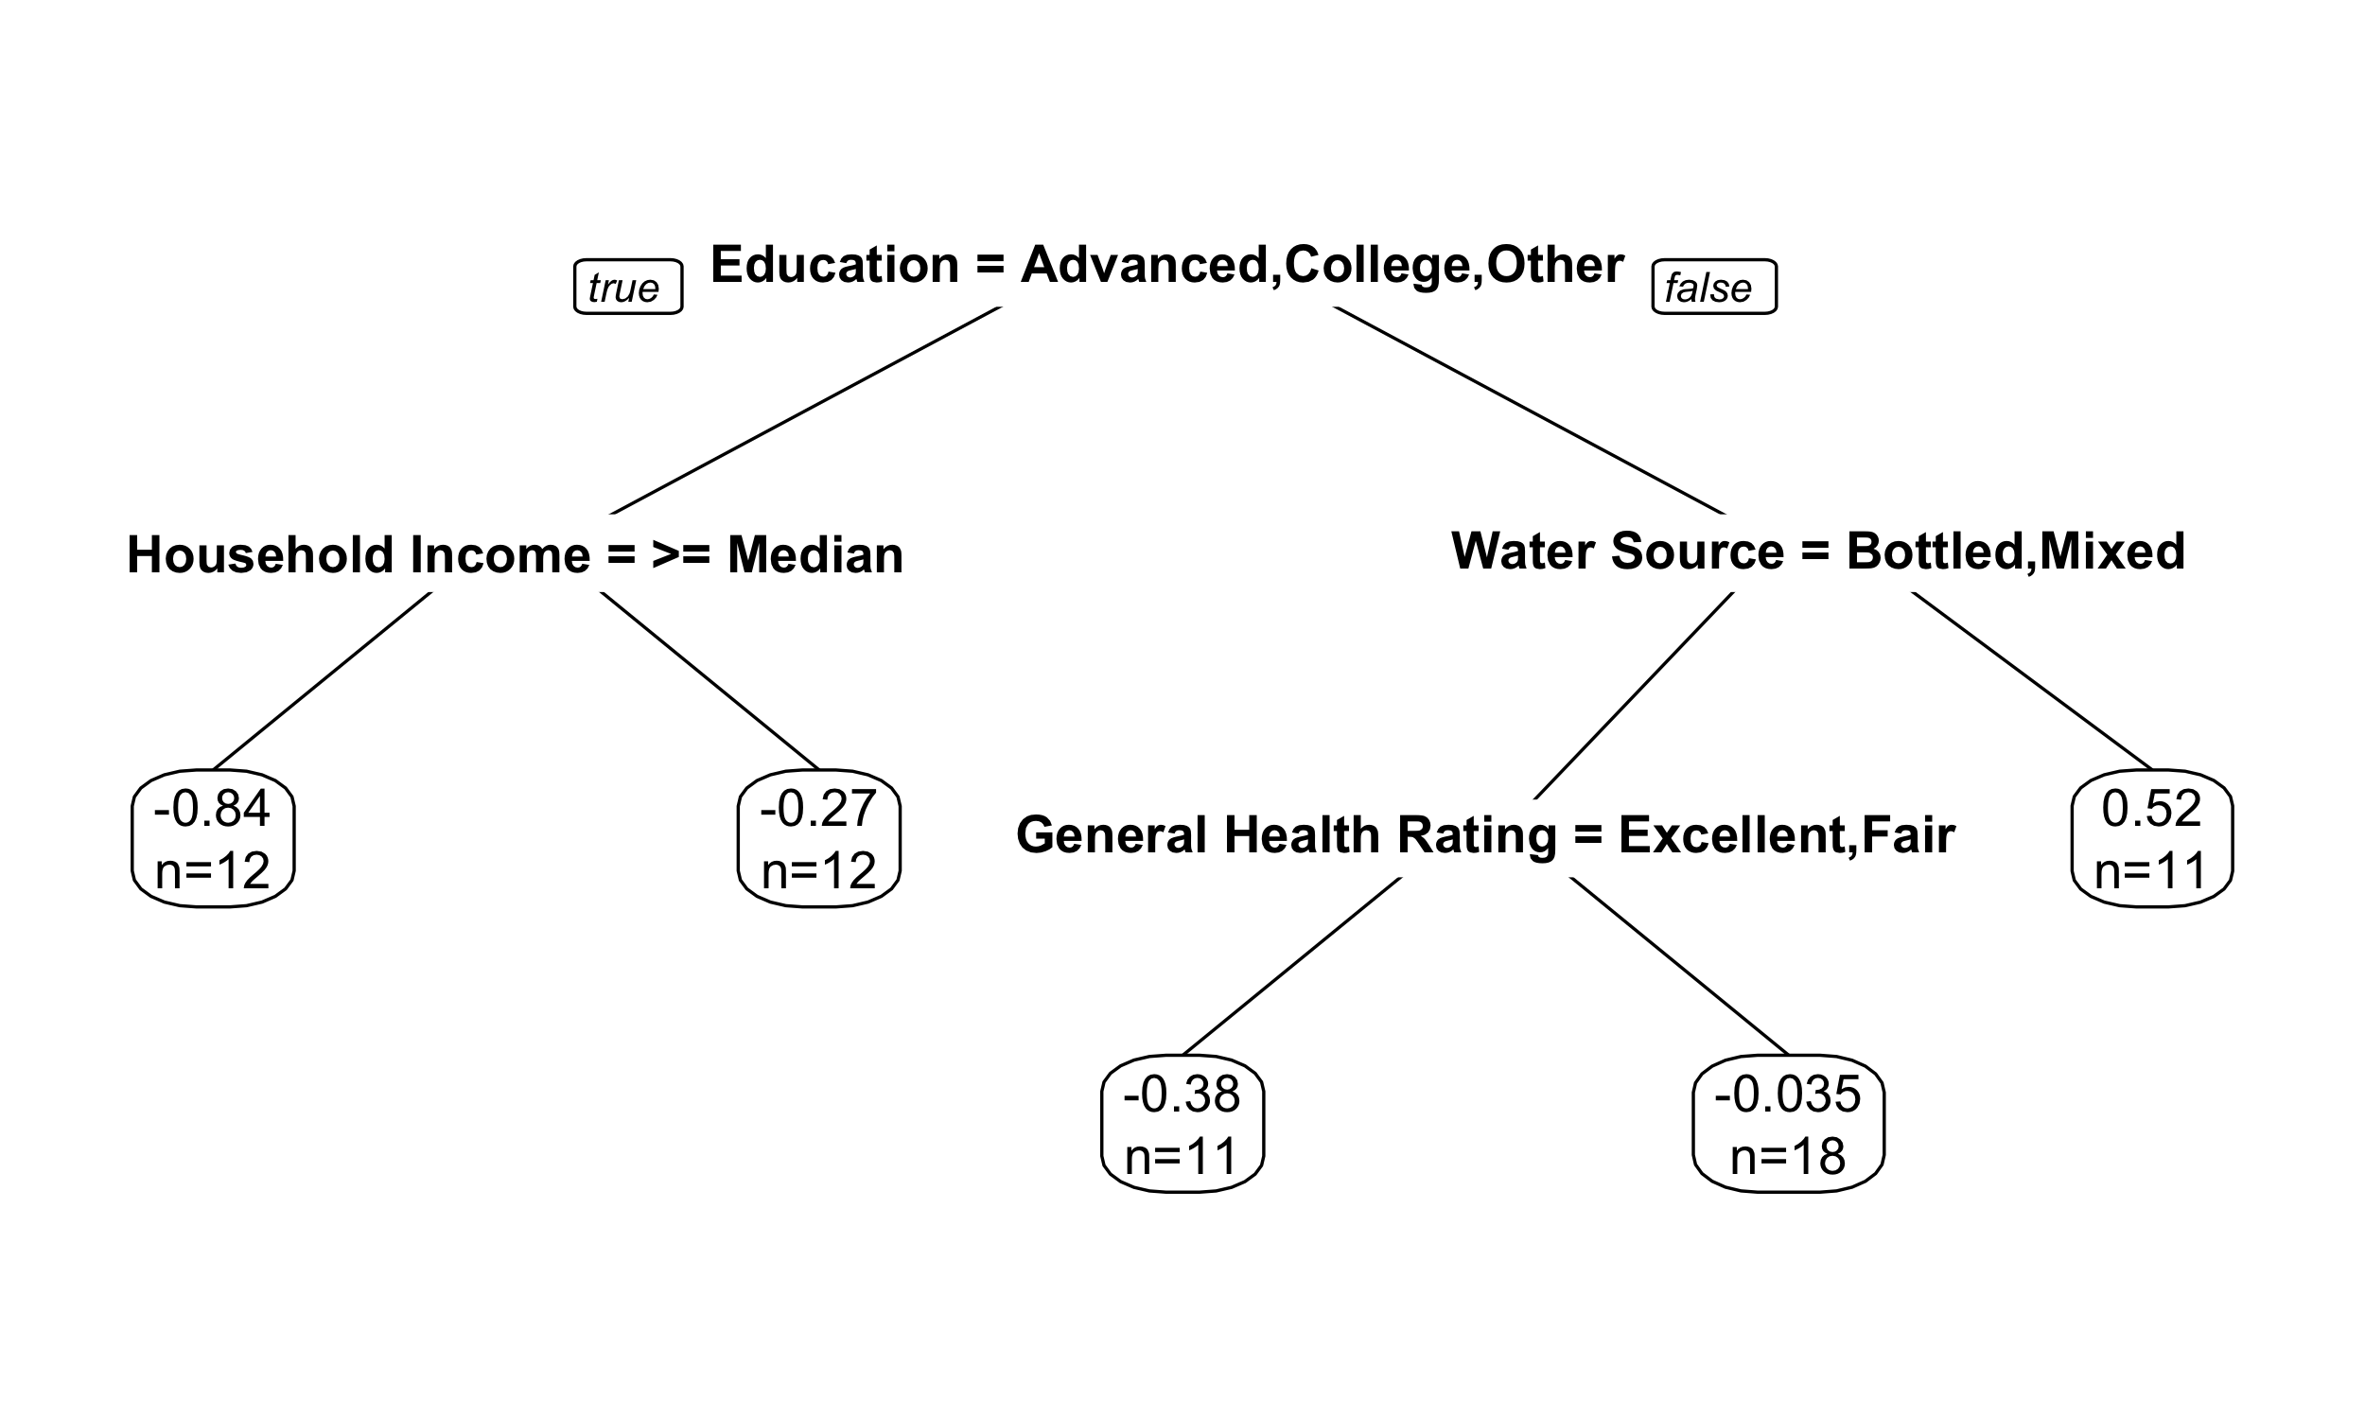
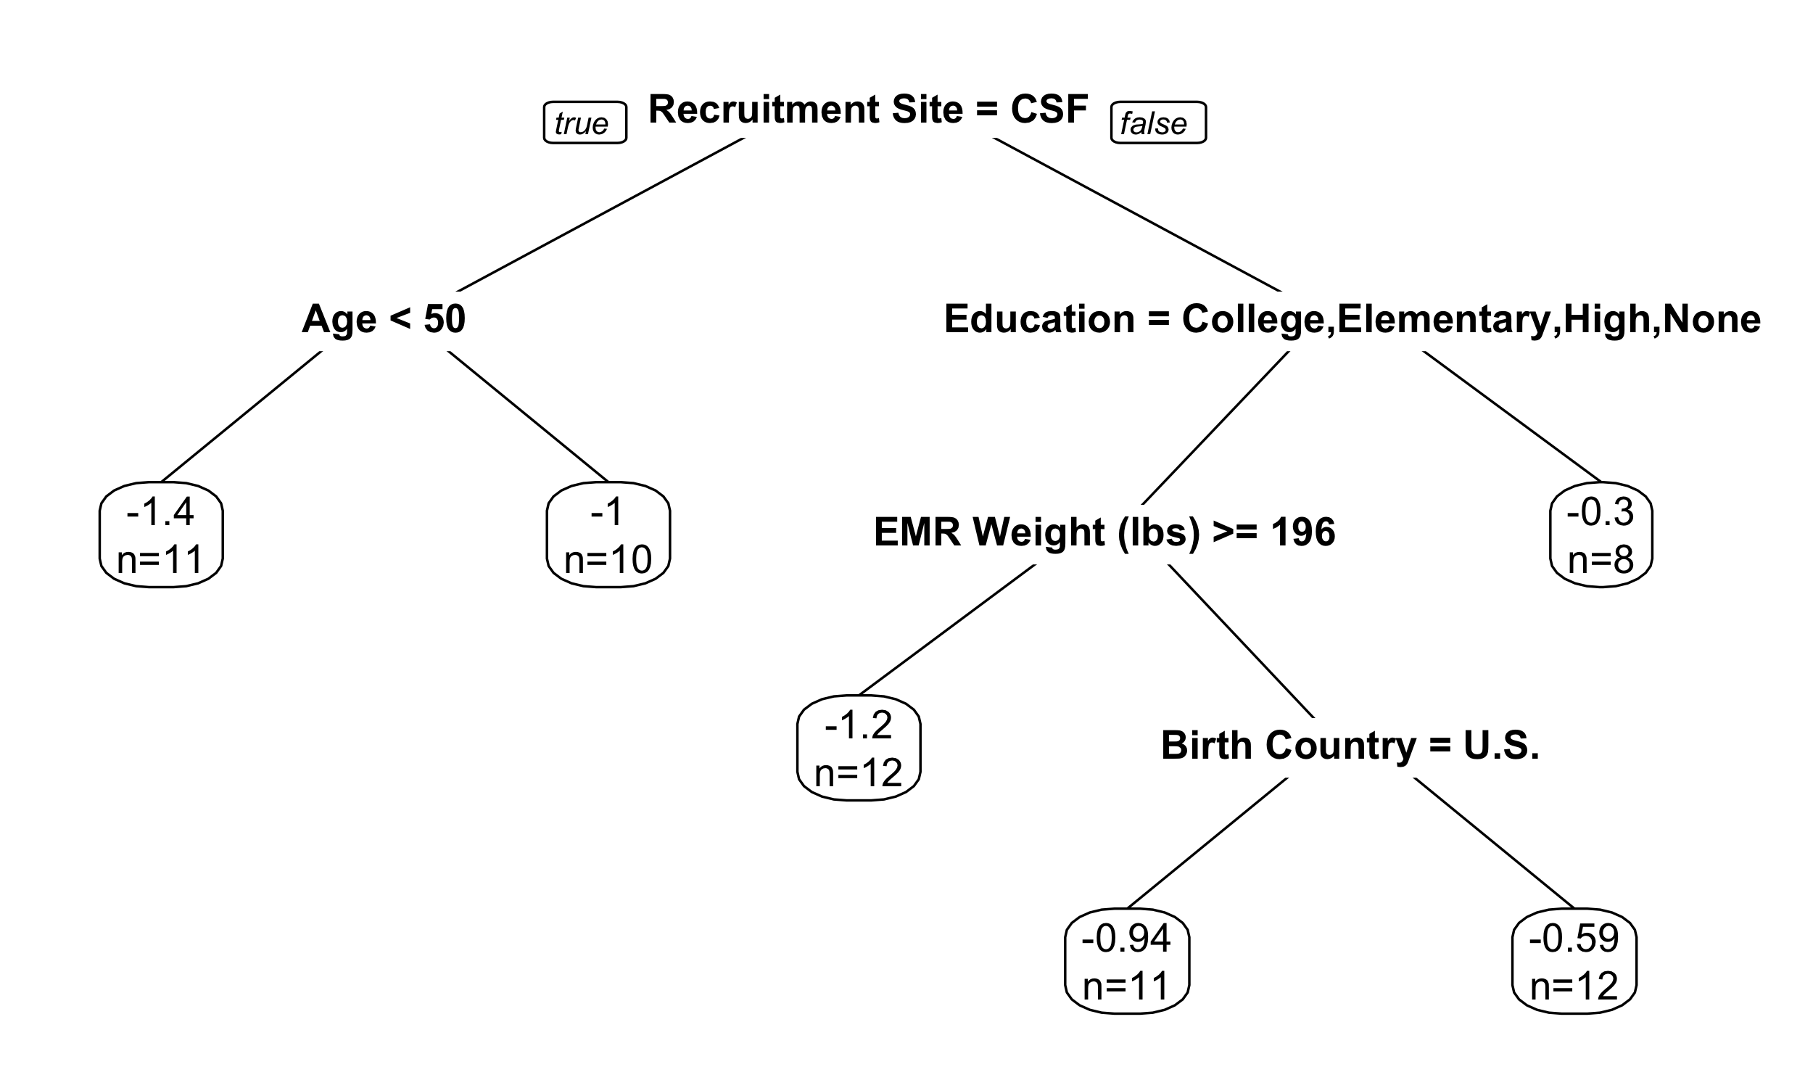
Notes:
Regression Full

Slide 2
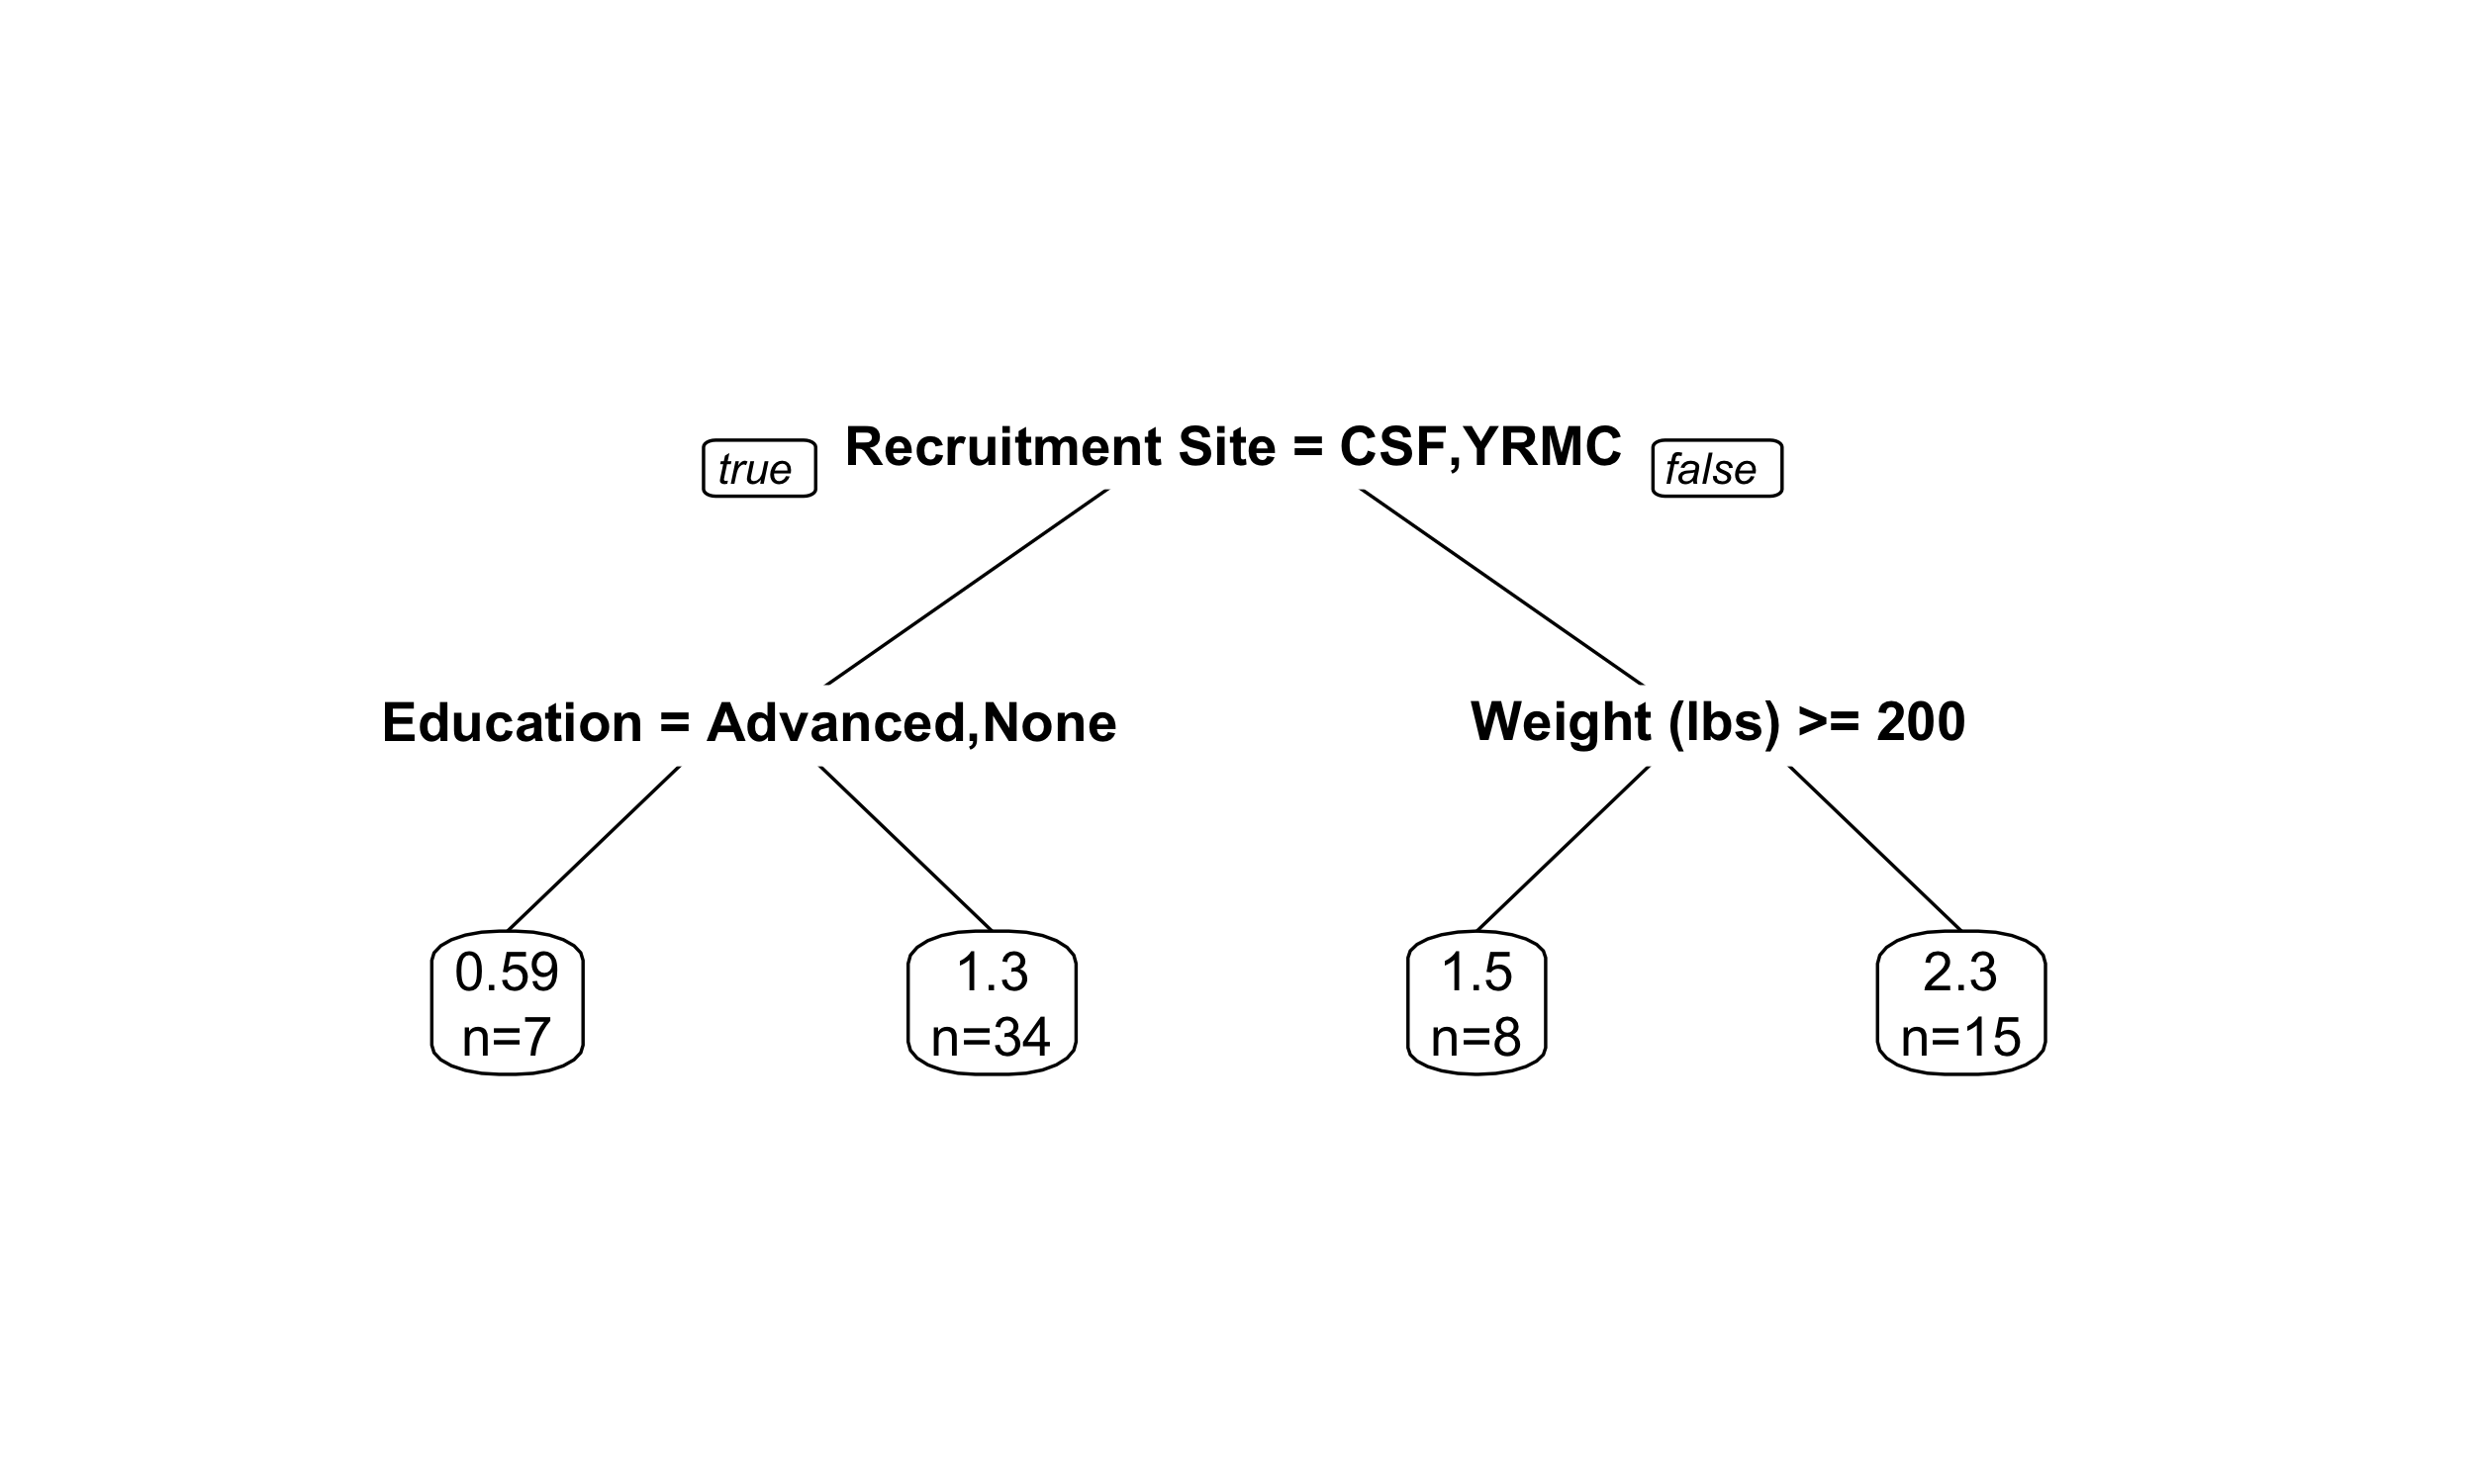
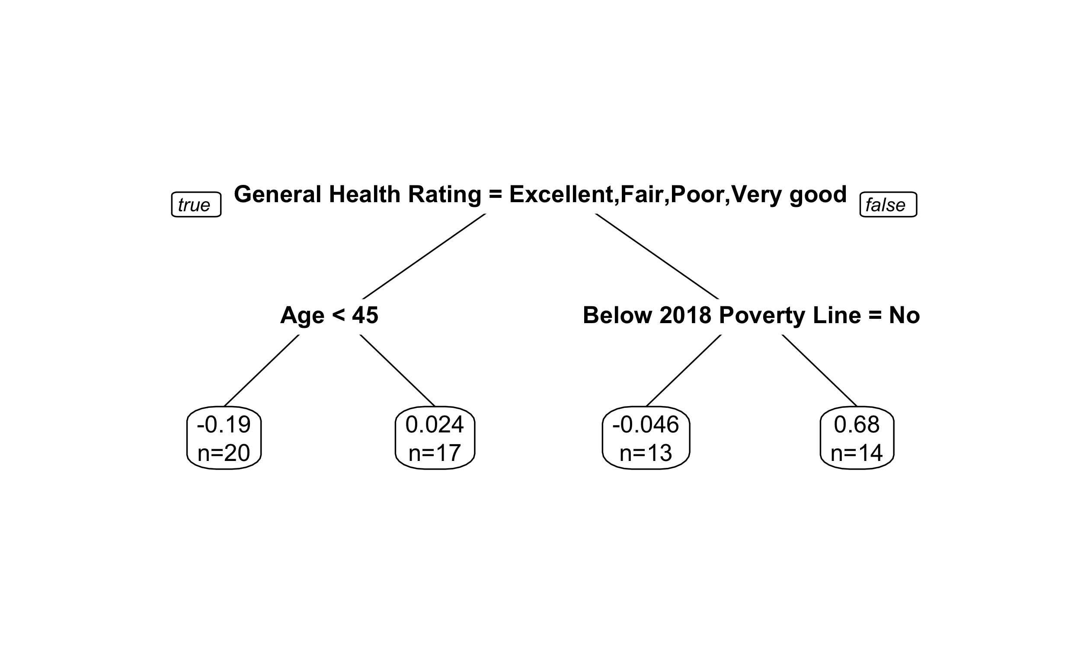


Copper
R² = 0.111
p < 0.001*
p = 0.181
p = 0.046*
Mercury
R² = 0.144
Manganese
R² = 0.108
p < 0.001*
p = 0.010*
p = 0.245
p = 0.596
p = 0.031*
p < 0.001*
Lead
R² = 0.010
Uranium
R² = 0.301
p = 0.005*
p < 0.001*
Notes:
Regression Pruned

Slide 3
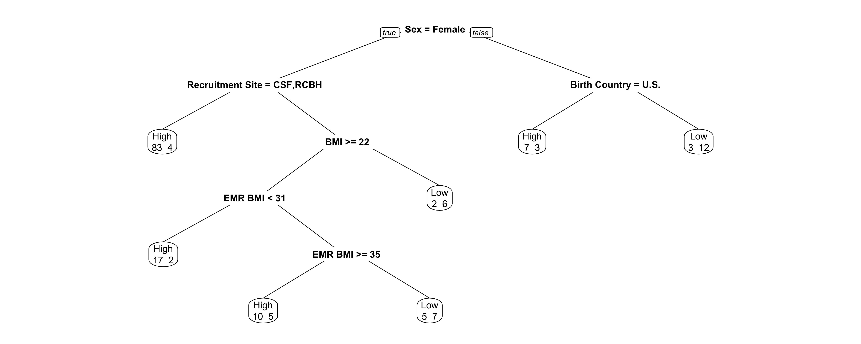
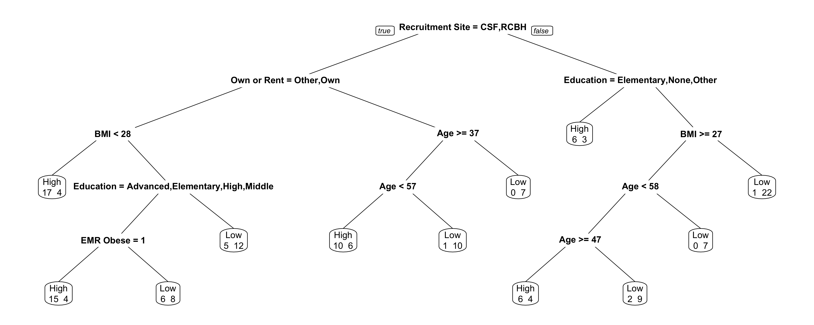

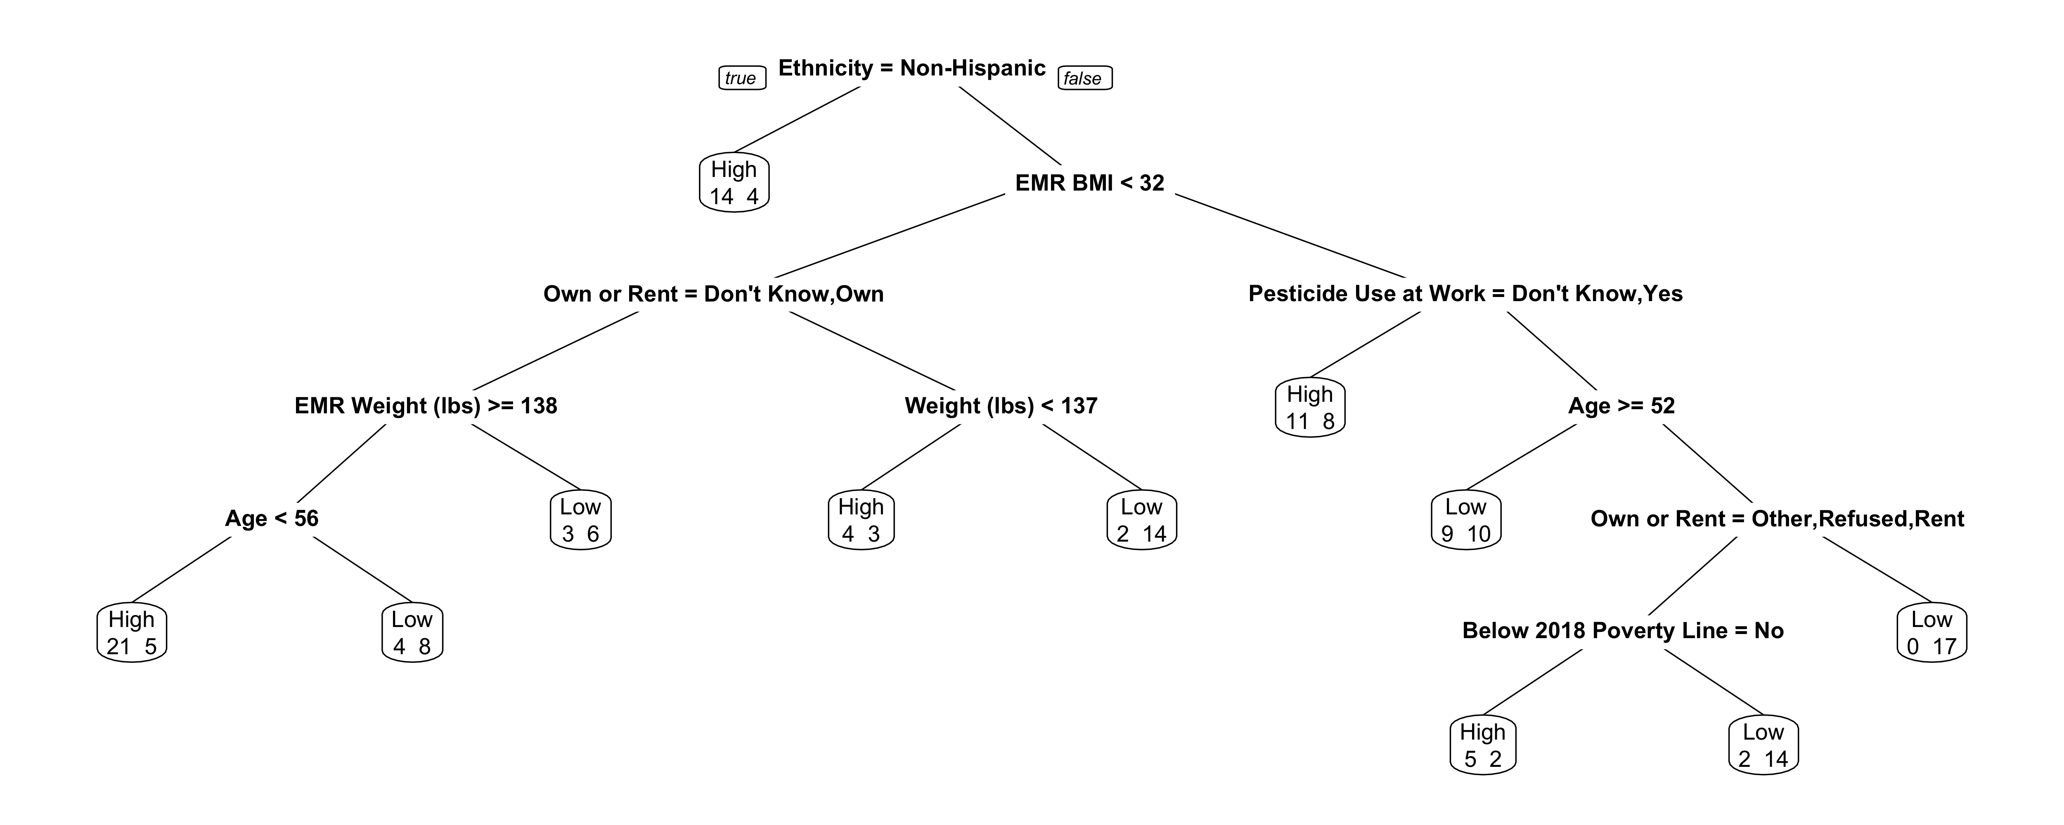

Notes:
Classification Full

Slide 4
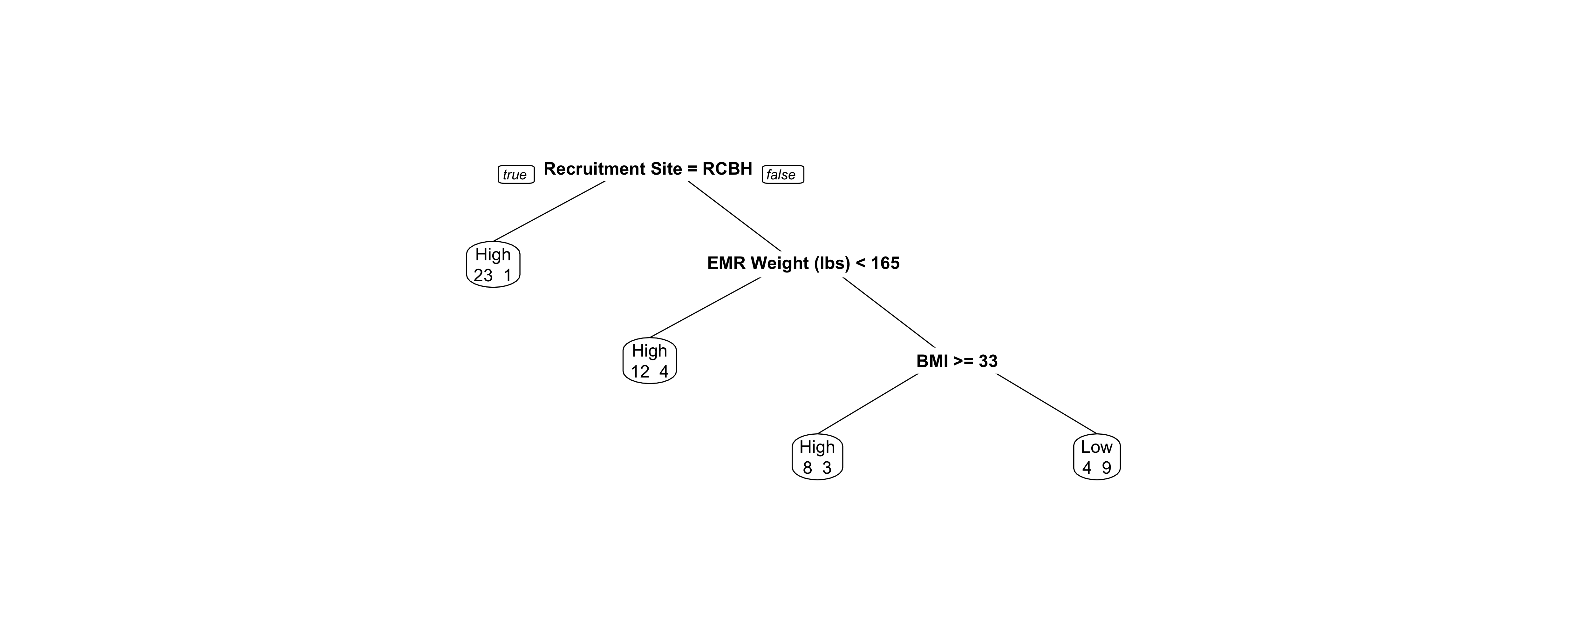

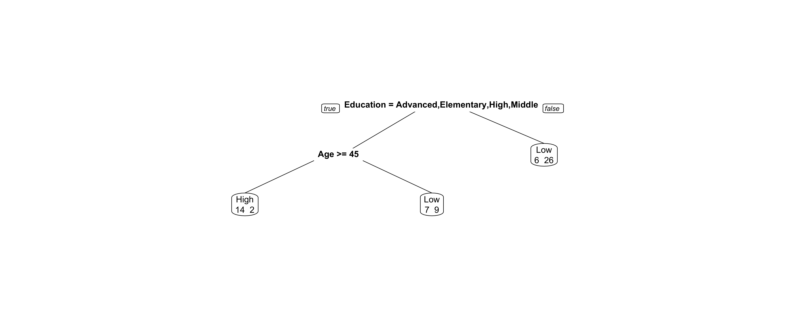

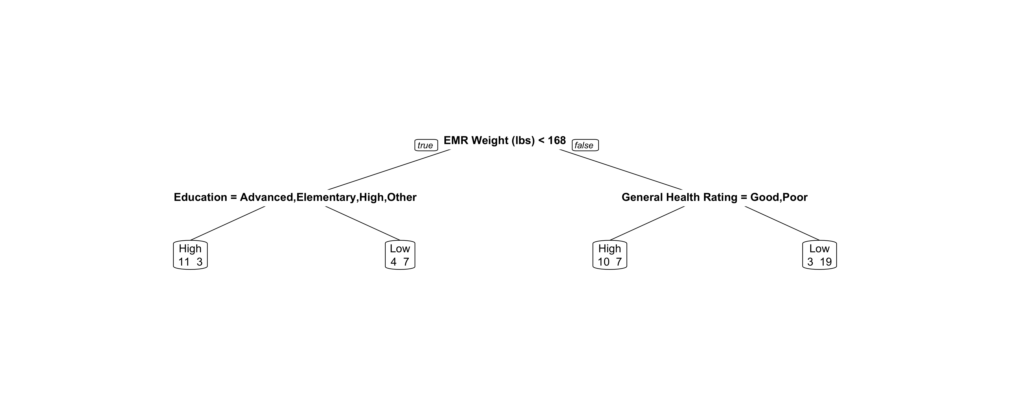
Copper
Prediction Rate = 93.3%
p = 0.002*
p = 0.346
Mercury
Prediction Rate = 100%
Manganese
Prediction Rate = 93.3%
Lead
Prediction Rate = 93.3%
p = 0.003*
p = 1.000
Uranium
Prediction Rate = 80.0%
p = 0.006*
p = 0.804
p = 0.125
Notes:
Classification Full

Slide 5
